Slide 1
ESC101: Fundamentals of Computing
Arrays of pointers
Nisheeth

Slide 2
The Golden Rules of Pointers
RULE 1: All pointers store addresses, take 8 bytes to store
Does not matter whether pointer to variable, to array, to another pointer etc
RULE 2 (Reference): &a gives address of variable a
Does not matter whether variable a is char, long, or even a pointer variable
Special case for static array variables – next slide
RULE 3: (Dereference): Whenever expression expr generates an address, *(expr) gives value stored at that address
RULE 4: (Arithmetic): Pointer arithmetic is w.r.t datatype
char* arithmetic w.r.t. 1 byte blocks, int* w.r.t. 4 byte blocks, double* 8 bytes
RULE 5: Name of array points to first element of array
Does not matter whether dynamic (e.g., malloc-ed) array or static array
Notes:
array points to the first element of the array. What does &array point to? It might seem like it points to the first element as well, but it doesn’t. It points to the whole array as one contiguous block of memory. Not convinced? Try printing out &array+1 and array+1 out side by side.

Slide 3
The Curious Case of Static Arrays
a, b, c all point to their respective first elements ☺
I will hide the location of the pointer a and b from you since I store these pointers secretly in a location called the symbol table – no access!!
Three types of arrays studied so far
Static arrays of fixed size int a[10];
Static arrays of variable size int n; scanf("%d",&n); int b[n];
Dynamic malloc/calloc/realloc-ed arrays int *c = (int*)malloc(n * sizeof(int));
For static arrays (fixed/variable length) sizeof() gives total size of array. However, for malloc-ed arrays, sizeof(c) just gives 8, the space required to store the pointer c ☹
&c gives us the address where the pointer c is stored ☺
&a just gives us the address of first element a[0] again ☹
&b just gives us the address of first element b[0] again ☹
You can modify the pointer c by saying c++ but I will not allow you to say things like a++, b++. I also dont allow you to free/realloc a and b ☺

Slide 4
The getline function: Revisited
Inception? ☺
Read a single line of text from input (i.e. till '\n')
Uses realloc-like methods to expand the char array size
For char array, we need a malloc-ed array for this reason
If user input doesn’t fit inside original array, str will contain pointer to expanded array, len will be length of new array
Pointer to a pointer simply stores the address of a pointer variable
int len = 11; // I only expect 10 characters to be entered
char *str = (char*)malloc(len * sizeof(char));
getline(&str, &len, stdin);
printf("%ld",*ptrstr) will print address of first char in str
printf("%c",**ptrstr) will print the first char in str
printf("%s",*ptrstr) will print entire string str
char **ptrstr = &str;
getline(ptrstr, &len, stdin); // Alternate way to use getline
WARNING: len may be larger than length of input + 1
Get actual length of input using strlen() from string.h

Slide 5



Array of pointers?
Note: ptrArr, ptrArr[0], ptrArr[1], ptrArr[2], each a pointer, will take 8 bytes to store – figure addressing is not accurate (shows one byte for each)
000000
000001
000002
000003
000004
000005
000006
000007
000008
000009
000010
000011
000012
000013
000014
000015
000016
000017
000018
000019
000020
000021
000022
000023
…
char *ptrArr[3];
int i;
for(i = 0; i < 3; i++)
ptrArr[i] = (char*)malloc((i+1)*sizeof(char));
scanf("%s", ptrArr[2]);
printf("%s", ptrArr[2]);
for(i = 0; i < 3; i++)
free(ptrArr[i]);
ptrArr
0 0 0 0 0 1 0 1
ptrArr[0]
ptrArr[1]
ptrArr[2]
0 0 0 0 1 1 0 0
* * * * * * * *
0 0 0 0 1 1 0 1
* * * * * * * *
0 0 0 0 1 1 1 1
Note: Array of pointers is equivalent to pointer of pointers
* * * * * * * *
i
Alternate, dynamic way to declare array of pointers
char **ptrArr = (char**)malloc(3*sizeof(char*));
Very useful in programs where we have to create an unknown number of arrays of unknown length
However, in this case we should also free pointer array by writing
free(ptrArr);

Slide 6
An Example: Printing all substrings
Read a string and create an array containing all its substrings (i.e. contiguous).
Display the substrings (note: non-unique substrings allowed, i.e., a substring may appear multiple times).
Input: ESC
Output:
E
ES
ESC
S
SC
C

Slide 7
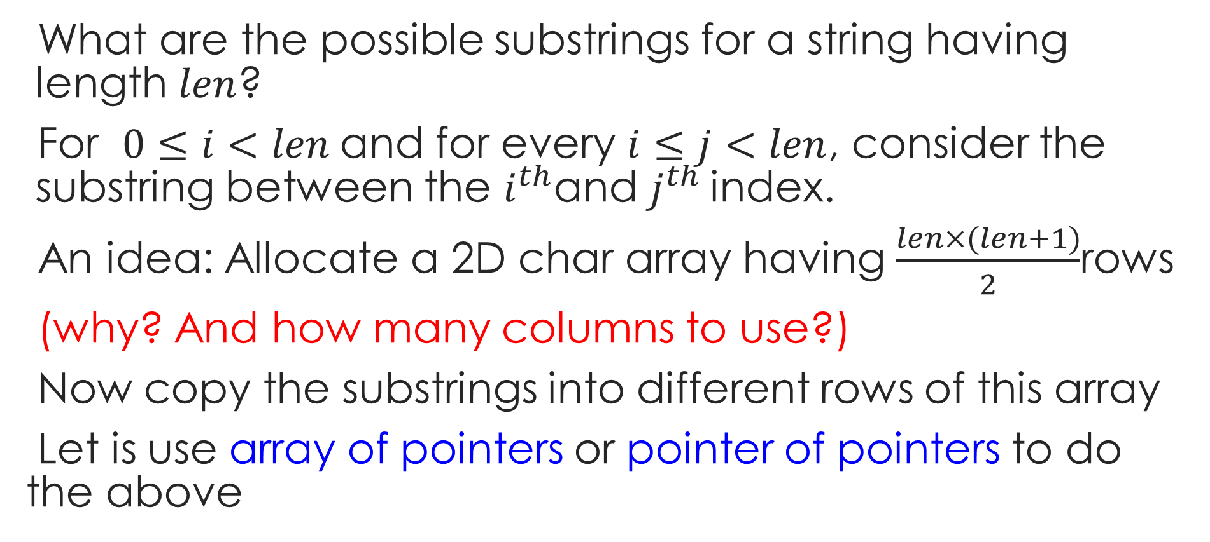
An Example: Printing all substrings
What are the possible substrings for a string having length $len$?
For $0≤i<len$and for every $i≤j<len$, consider the substring between the $i^{th}$and $j^{th}$index.
An idea: Allocate a 2D char array having $\frac{len×(len+1)}{2}$rows
(why? And how many columns to use?)
Now copy the substrings into different rows of this array
Let is use array of pointers or pointer of pointers to do the above

Slide 8
int len, i, j, k=0, nsubstr;
char st[100], **substrs;
scanf("%s",st);
len = strlen(st);
nsubstr = len*(len+1)/2;
substrs = (char**)malloc(sizeof(char*) * nsubstr);
for (i=0; i<nsubstr; i++)
substrs[i] = (char*)malloc(sizeof(char) * (len+1));
for (i=0; i<len; i++){
for (j=i; j<len; j++){
strncpy(substrs[k], st+i, j-i+1);
k++;
}
}
for (i=0; i<k; i++)
printf("%s\n",substrs[i]);
Solution: Version 1
for (i=0; i<k; i++)
free(substrs[i]);
free(substrs);

Slide 9
Wasted too much space..
E | ‘\0’
E | S | ‘\0’
E | S | C | ‘\0’
S | ‘\0’
S | C | ‘\0’
C | ‘\0’

Slide 10
int len, i, j, k=0,nsubstr; char st[100], **substrs;
scanf("%s",st);
len = strlen(st);
nsubstr = len*(len+1)/2;
substrs = (char**)malloc(sizeof(char*) * nsubstr);
for (i=0; i<len; i++)
for (j=i; j<len; j++){
substrs[k] = (char*)malloc(sizeof(char) * (j-i+2));
strncpy(substrs[k], st+i, j-i+1);
k++;
}
for (i=0; i<k; i++)
printf("%s\n",substrs[i]);
Solution: Version 2
for (i=0; i<k; i++)
free(substrs[i]);
free(substrs);
This version uses much less memory compared to version 1
10

